Slide 1
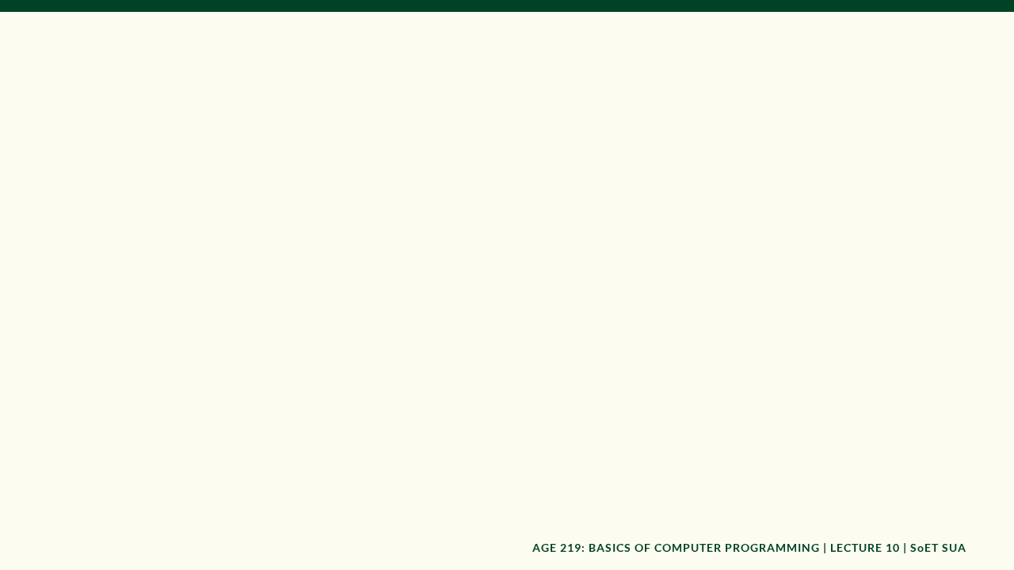

AGE 219: Final Project
Integration & Systems
Capstone: The Smart Grain Bin Manager
Dr. Kadeghe Fue, PhD, P.Eng (T)
AI & Robotics Specialist | Office: EPAL | SoET SUA

Slide 2
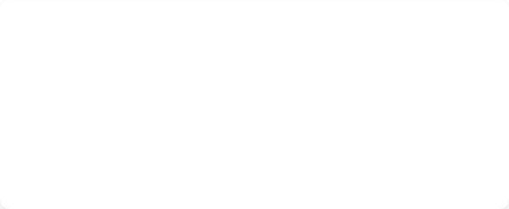
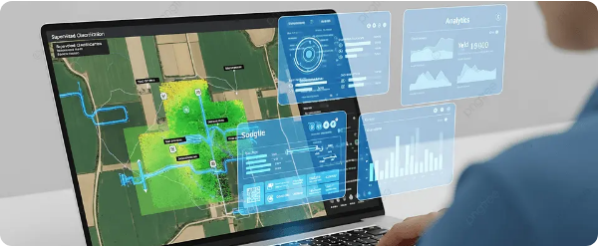
Recap: Lecture 9 Analytics
Yesterday, we learned to turn raw sensor streams into engineering intelligence using NumPy, Pandas, and Matplotlib.

Slide 3


Systems Engineering Foundations
What is a System?
The Engineer's Role
An integration of components (hardware + software) working together to achieve a specific goal.
Your job is to synthesize variables, loops, functions, classes, and analytics into a unified, functional machine.
In AGE 219, we transition from writing "scripts" to building "Systems."

Slide 4

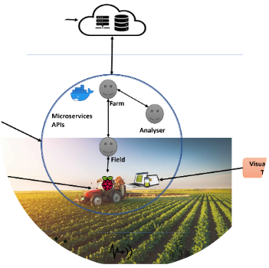
Concept of Systems Thinking
Agriculture 4.0
Digital Agriculture bridges the gap between physical laws (mechanics, biology) and real-time computation.
The Digital Twin concept allows us to simulate physical hardware behavior (like a silo) in a virtual environment.

Slide 5

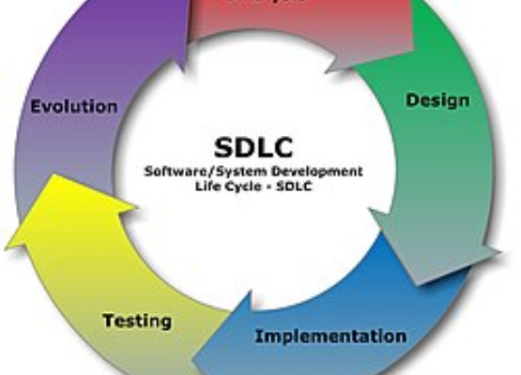
Software Development Life Cycle
The SDLC for Engineers
Requirements: What must the bin do?
Design: Creating the OOP Blueprint.
Implementation: Coding the simulation.
Testing: Verifying fan logic works.

Slide 6

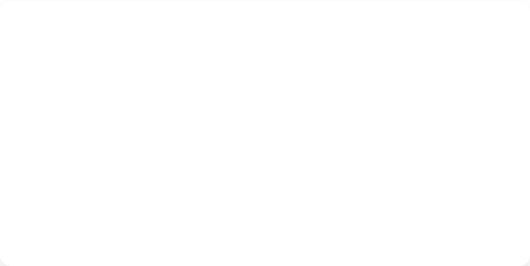
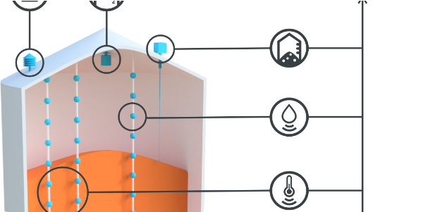
Capstone Case Study
The Smart Grain Bin Manager

Slide 7
Requirements: Post-Harvest Needs
Monitor: Internal temp and moisture every hour.
Analyze: Identify risks of spoilage or mold growth.
Control: Activate aeration fans if conditions degrade.
Audit: Log all data for historical auditing.
Visualize: Generate daily status reports for management.

Slide 8
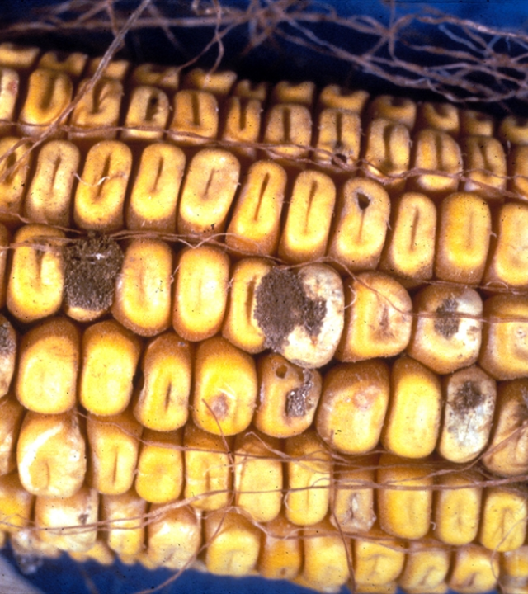
The Spoilage Problem
Preventing Massive Loss
In Tanzania, high humidity and temperature lead to rapid mold growth in stored Maize. Programmed monitoring can reduce post-harvest losses by up to 30%.
Our system uses logic to maintain conditions within the Safe Storage Zone.

Slide 9






Architecture: The 'Digital Twin'
Objects
Functions
Files
The GrainBin class stores hardware state (Sensors, Fan status).
Modular logic calculates EMC (Equilibrium Moisture Content).
The history list persists data to CSV logs.

Slide 10

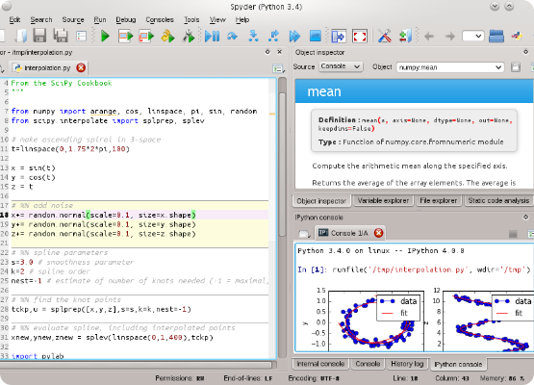
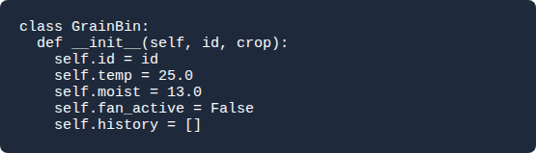
Phase 1: Object Model
Defining Hardware in Code

Slide 11



Phase 2: Modular Logic
The Brain
Control Logic
A specialized function to evaluate environmental risk.
If Temp > 32 OR Moist > 14.5:
Fan Status = True
Else:
Fan Status = False

Slide 12
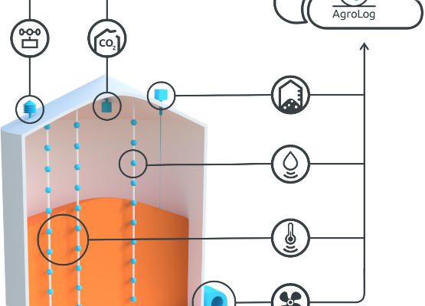
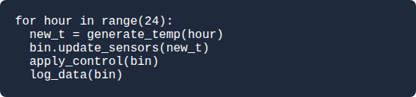
Phase 3: Field Simulation
Simulating 24 Hours
We use a for loop to simulate ambient temperature changes and sensor data ingestion.

Slide 13
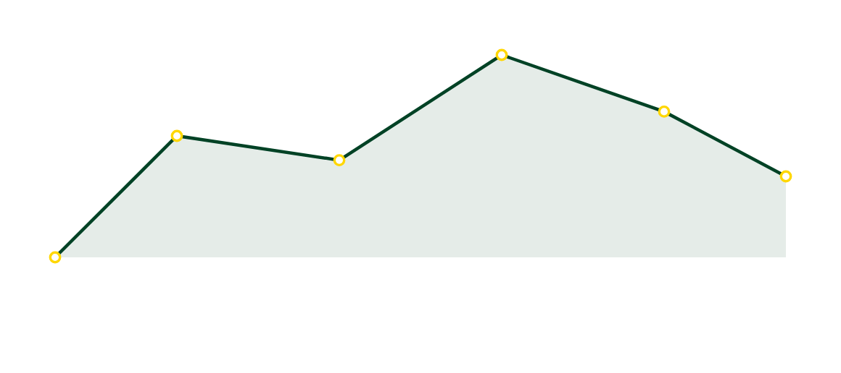
Phase 4: Data Visualization
The system generates 24-hour environmental logs using Matplotlib. The trend shows the critical cooling points where fans were activated.

Slide 14
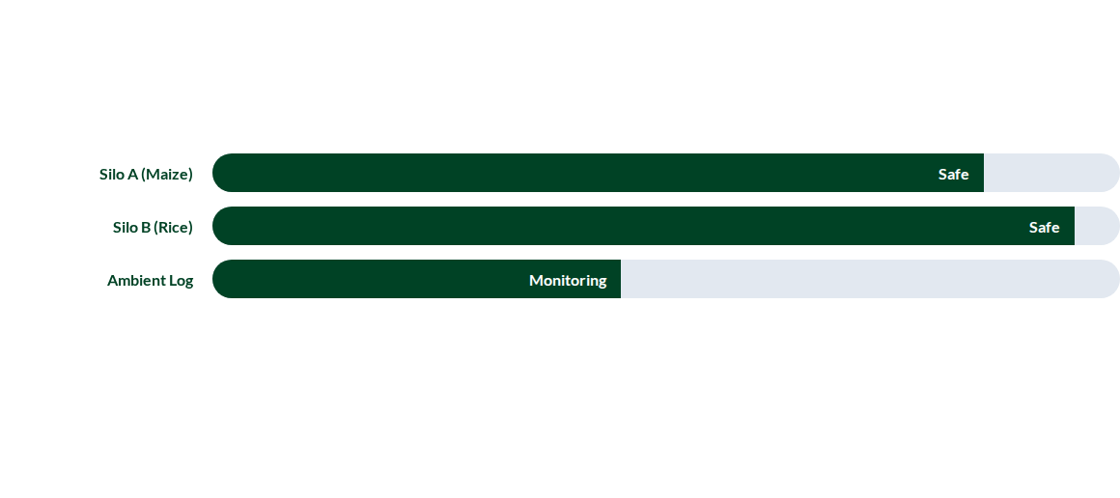
System Integration Performance
Comparison of integrated silo states across the farm management dashboard.

Slide 15
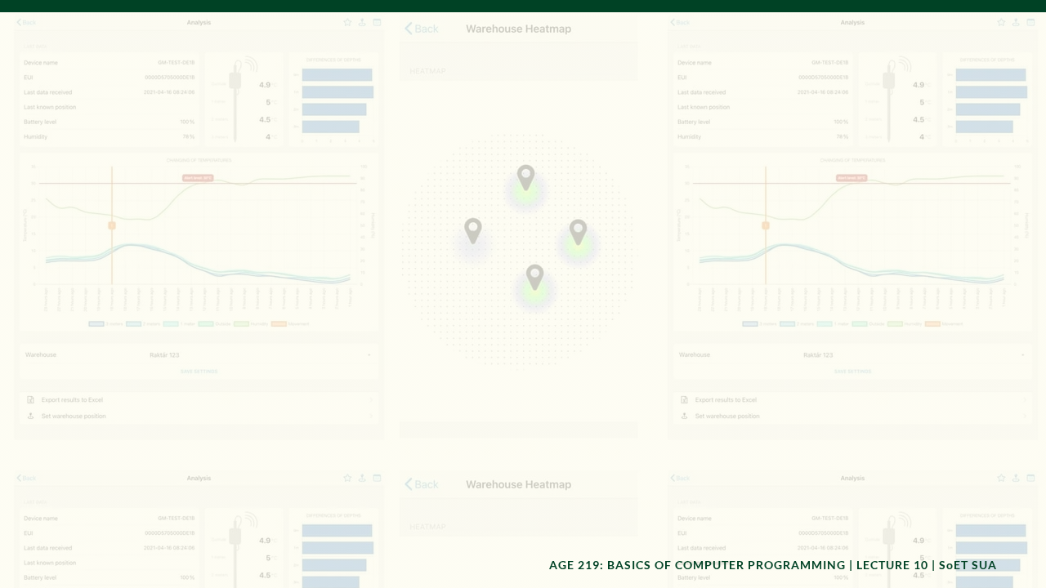
The Complete Integrated Script
In our lab, we will combine all 10 Modules into a single 150-line Python application. This marks the culmination of your journey from "Hello Farm" to "Systems Engineer."

Slide 16

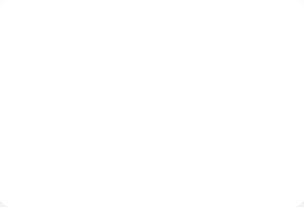
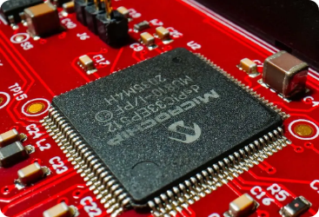

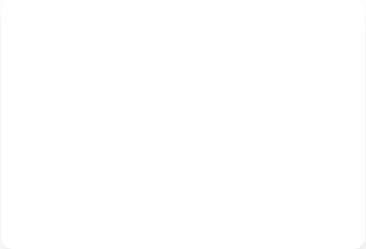
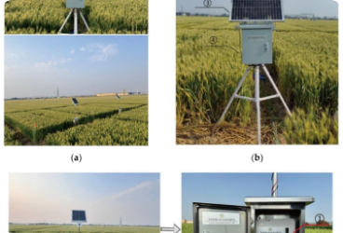

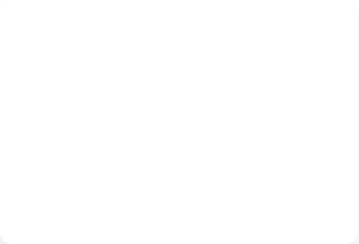
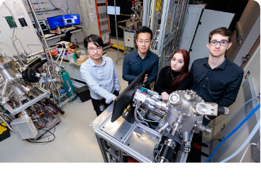
Deployment & Field Robustness
Hardware Integration
Field Connectivity
Calibration & Tests

Slide 17
Looking Ahead: Your Pathway
AGE 316
AGE 418
Microcomputer Systems
Precision Ag Control
AGE 219
AGE 328
Foundations & Core Logic
Comm & Networks

Slide 18

Professional Responsibility
"
With great power comes great responsibility. Engineering solutions protect our food security.
— SoET Professional Ethics

Slide 19
Prerequisite Accomplishment
10
Ready for Precision Ag
You have completed the foundational requirements to design automated systems in AGE 418: Sensors and Controls. The logic you wrote here is the exact logic used in global precision agriculture hardware.
Modules Mastered

Slide 20


Closing Reflections
Engineering Success
Programming is no longer an "elective" skill for agricultural engineers; it is the core differentiator. Keep practicing, keep coding, and keep innovating for Tanzania's future.

Slide 21

Questions?
Thank you for a great semester.
Dr. Kadeghe Fue | Office: EPAL
School of Engineering and Technology (SoET)
Morogoro, Tanzania

